Slide 1
Vector Tools for
Computer Graphics
Computer Graphics

Slide 2
Basic Definitions
Points specify location in space (or in the plane).
Vectors have magnitude and direction (like velocity).
Points ≠ Vectors

Slide 3
Basics of Vectors
v
Vector as displacement:
v is a vector from point P to point Q.
P
v
Q
The difference between two points is a vector: v = Q - P
Another way:
The sum of a point and a vector is a point : P + v = Q
Q
P
v

Slide 4
Operations on Vectors
Two operations
Addition
a + b
a = (3,5,8), b = (-1,2,-4)
a + b = (2,7,4)
Multiplication be scalars
sa
a = (3,-5,8), s = 5
5a = (15,-25,40)
operations are done componentwise

Slide 5
Operations on vectors
Addition
b
a+ b
a+ b
b
a
a
Multiplication by scalar
a
2a
-a

Slide 6
Operations on vectors
Subtraction
a-c
a-c
a
a
a
c
-c
c

Slide 7
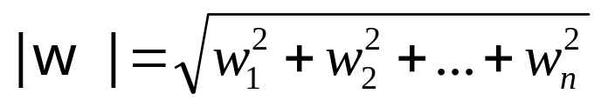
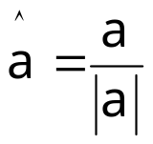
Properties of vectors
Length or size
w = (w₁,w₂,…,w_{n})
Unit vector
The process is called normalizing
Used to refer direction
The standard unit vectors: i = (1,0,0), j = (0,1,0) and k = (0,0,1)

Slide 8

Dot Product
The dot product d of two vectors v = (v₁,v₂,…,v_{n}) and w = (w₁,w₂,…w_{n}): |v| |w|
Properties
Symmetry: a·b = b·a
Linearity: (a+c) ·b = a·b + c·b
Homogeneity: (sa) ·b = s(a·b)
|b|² = b·b

Slide 9
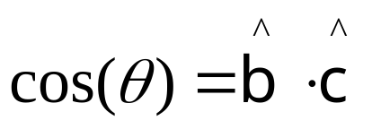
Application of Dot Product
Angle between two unit vectors b and c
y
c
b
θ
Φ_{c}
Φ_{b}
x
Two vectors b and c are perpendicular (orthogonal/normal) if
b·c = 0

Slide 10
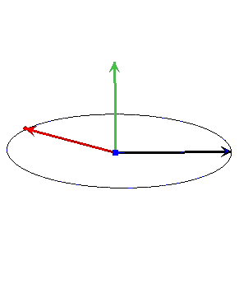
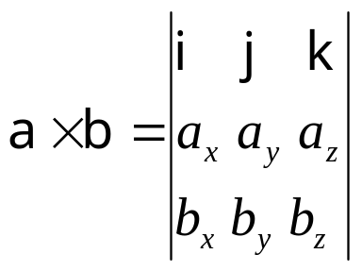
Cross Product
Also called vector product.
Defined for 3D vectors only.
Properties
Antisymmetry: a Χ b = - b Χ a
Linearity: (a +c) Χ b = a Χ b + c Χ b
Homogeneity: (sa) Χ b = s(a Χ b)

Slide 11
Geometric Interpretation of Cross Product
y
axb
a
P₁
P₃
b
P₂
x
z
aXb is perpendicular to both a and b
| aXb | = area of the parallelogram defined by a and b

Slide 12
2D perp Vector
Which vector is perpendicular to the 2D vector a = (a_{x},a_{y})?
Let a = (a_{x},a_{y}).
Then
a┴ = (-a_{y},a_{x})
is the counterclockwise perpendicular to a.
a┴
a
-a┴
a
a= a_{x} + ia_{y}
ia= i a_{x-}a_{y} [multiply i on both sides for counter clock wise perpendicular of 2D vector]
= -a_{y}+ia_{x} = (-a_{y,} a_{x} )
What about 3D case?

Slide 13
Rotation in 2d
We want to rotate a 2d vector v counterclockwise by an angle A
First we determine perp(v), v┴
Then we scale v by cosA and scale v┴ by sinA and take their sum
v´ = vcosA+ v┴sinA
v┴
v´
v
v┴sinA
A
vcosA

Slide 14
Rotation in 3d
We want to rotate a 3d vector l counterclockwise with respect to a 3d unit vector r by an angle A, where l and r are perpendicular to each other
First we determine the vector u, that is perpendicular to both l and r and have a length equal to that of l
So, u = r X l
Then we scale l by cosA and scale u by sinA and take their sum
u
* note that, this method is applicable only in cases where the axis of rotation and the vector which is to be rotated are perpendicular to each other
l
usinA
A
lcosA
r

Slide 15
Orthogonal Projection
We want to decompose the vector c into two vectors, one along the direction of a unit vector v and another along perp(v)
The length of the orthogonal projection of c along v is c.v
(as v is a unit vector)
Thus the component (or orthogonal projection) of c along v is (c.v)v
c
v┴
v
c.v

Slide 16
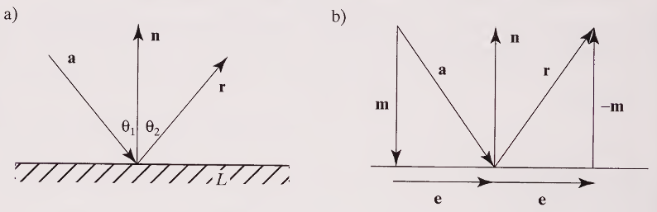


Application of Projection: Reflection
From Fig-a, a ray having direction a, hitting line L, and reflecting in (an as yet unknown) direction r. The vector n is perpendicular to the line. Angle Ө₁ must equal to angle Ө₂.
From Fig-b shows a resolves into portion m along n and a portion e orthogonal to n, Because of symmetry, r has the same component e orthogonal to n, but the opposite component along n, so r=e-m.
Because e=a-m, it follows that r=a-2m, Now m is the orthogonal projection of a onto n, so
So the direction of the reflected ray is given by

Slide 17
Representing Lines [11][12]
Line
Ray
2 types of representations:
Two point form
Parametric representation

Slide 18
Parametric Representation of a Line
y
B (x, y)
t > 1
v( a, b)
C (x_{0,} y₀ )
t = 1
t = 0
t < 0
x
r₀₌ r+vt
(x,y)= (x_{0,} y₀)+ (a,b)t
x= x₀+ at
y= y₀ + bt

Slide 19
Planes in 3D
4 fundamental forms
  Three-point form
  Parametric representation
  Point normal form
  Equation

Slide 20

Parametric Representation of Plane
A point in a plane and 2 vector direction to plane
C
b
a

Slide 21
Point Normal Form of a Plane
A point in a plane and a normal vector onto to the plane
n
B
For an arbitrary point R(x, y, z) in the plane, the vector from R to B must be perpendicular to n, giving n. (R-B)=0. This is the point normal form of the equation.

Slide 22
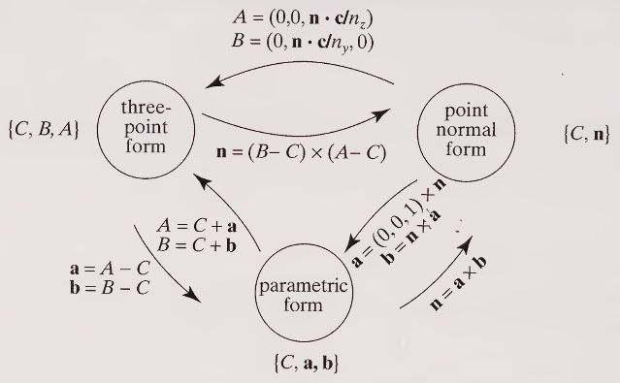
Conversion of The Plane Representation

Slide 23
Equation of a Plane [1][2][3][4]
ax + by + cz = d is the standard equation of a plane in 3d
If sqrt(a^2 + b^2 + c^2) = 1, then it is called the normalized form
In the normalized form, |d| equals the distance of the plane from the origin
Y
What about distance from an arbitrary point?
(x, y)
n_{y}
How to convert between equation and the other forms?
n_{x}
p.n
P = (p_{x}, p_{y})
X
L

Slide 24
Line-Plane Intersection [8]
Plane: ax + by + cz =d
Line: P + tV
Determine the specific value of t (say t’) for which the equation of the plane is satisfied, i.e., the point on the line lies on the plane

Slide 25
Line-Line Intersection [5][6][7]
Four possible cases:
  Coincident
  Parallel
  Not parallel and do not intersect
  Not parallel and intersect

Slide 26
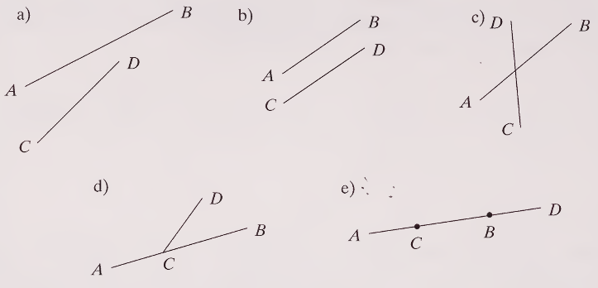

Line-Line Intersection
L₁: P₁ + tV₁
L₂: P₂ + sV₂
Parallel if V₁ and V₂ are in the same or opposite direction (i.e., the angle between them are 0 degree or 180 degree)
Coincident if they are parallel and have at least one point in common
If they are not parallel, how to decide whether they intersect or not?
b = B-A
d = D-C
c = C-A

Slide 27
Line-Line Intersection
If they are not parallel, how to decide whether they intersect or not?
One solution
  Generate three equations for two unknowns
  Solve the first two equations to find a solution
  Check whether the solution satisfies the third equation
Another solution
  Check whether (P₁ – P₂).(V₁ X V₂) = 0
  If lines intersect this condition must hold
  If lines do not intersect, is it sure not to hold?

Slide 28
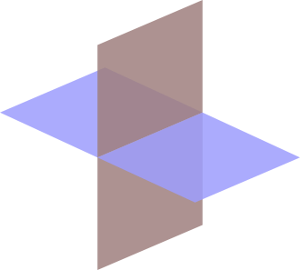
Plane-Plane Intersection [9][10]
Intersection is a line
So we need two points on the line, or one point and the direction
How to get a point on the intersecting line?
How to get the direction of the intersecting line?

Slide 29
Plane-Plane Intersection
How to get a point on the intersecting line?
    Imagine another plane not parallel to any of the given planes, for example the plane z = 0 (the XY plane)
    Now solve three plane equations to find their common intersection point

Slide 30
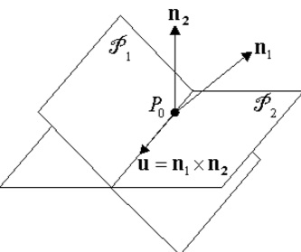
Plane-Plane Intersection
How to get the direction of the intersecting line?
Consider the planes in point-normal form
  Plane 1: P₁, n₁
  Plane 2: P₂, n₂
n₁ and n₂ are both perpendicular to the intersecting line
So the direction of the line of intersection is along n₁ X n₂

Slide 31
Problems
Given a=(4,-2) and n=(0,3). Find the reflected vector and the angle with incidence.
Find a parametric form for a line that passes through C=(3,5) and B=(2,7).
For a line, two points B (5,-2) and C (3,4). Convert it to point normal form.
Convert to parametric form: For a place 3 points given A= (3,3,3), B=(5,5,7), C=(1,2,4).
Find the parametric form of the plane equation given as 2x-y+3z=8.

Slide 32
Problems
Given the equation of a normal vector is 4i+3j+8k=0 and a point p=(1,2,3). Derive the equation of the plane.
Given the equation of the plane, 2x+3y+4z+5=0. Find the distance from the origin.
Given a plane equation 3x+4y+3z+10=0 passing through a point (-1,-1,-1). Convert to point normal form.

Slide 33
Links
[1] http://www.songho.ca/math/plane/plane.html
[2] http://mathinsight.org/distance_point_plane
[3] https://www.youtube.com/watch?v=gw-4wltP5tY
[4] https://www.youtube.com/watch?v=7rIFO8hct9g
[5] https://www.youtube.com/watch?v=nKVCvY-FW5Q
[6] https://www.youtube.com/watch?v=FlLbI7DB0SM
[7] https://www.youtube.com/watch?v=r5DwyBFxD7Q
[8] https://www.youtube.com/watch?v=Td9CZGkqrSg
[9] https://www.youtube.com/watch?v=nZ2mS5M4fcQ
[10] https://www.youtube.com/watch?v=LpardiBTAvU
[11] https://www.youtube.com/watch?v=PyPp4QvQY3Q

